Slide 1
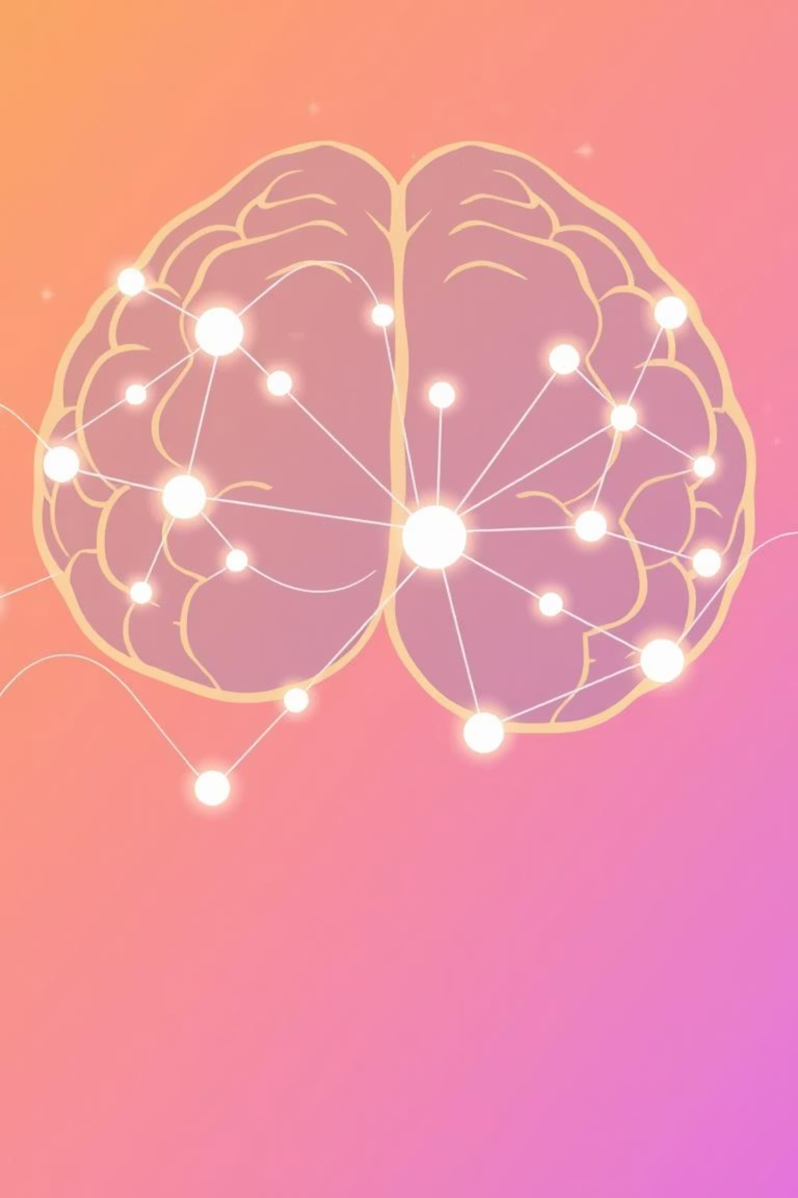
Unveiling Deep Learning: From Neurons to Networks
Embark on a journey to understand the foundational concepts of deep learning, starting with its biological inspirations and progressing to the mechanics of artificial neural networks.

Slide 2
Agenda
Biological vs. Artificial Neurons: The Inspiration
Perceptrons: The Building Blocks
Activation Functions: Sparking Action
Forward Propagation: The Flow of Information
Loss Functions: Quantifying Error
Optimization: Learning from Mistakes
Backpropagation: The Learning Algorithm
Training Process: Iterative Improvement
Overfitting & Underfitting: Common Challenges
Key Takeaways & Next Steps

Slide 3
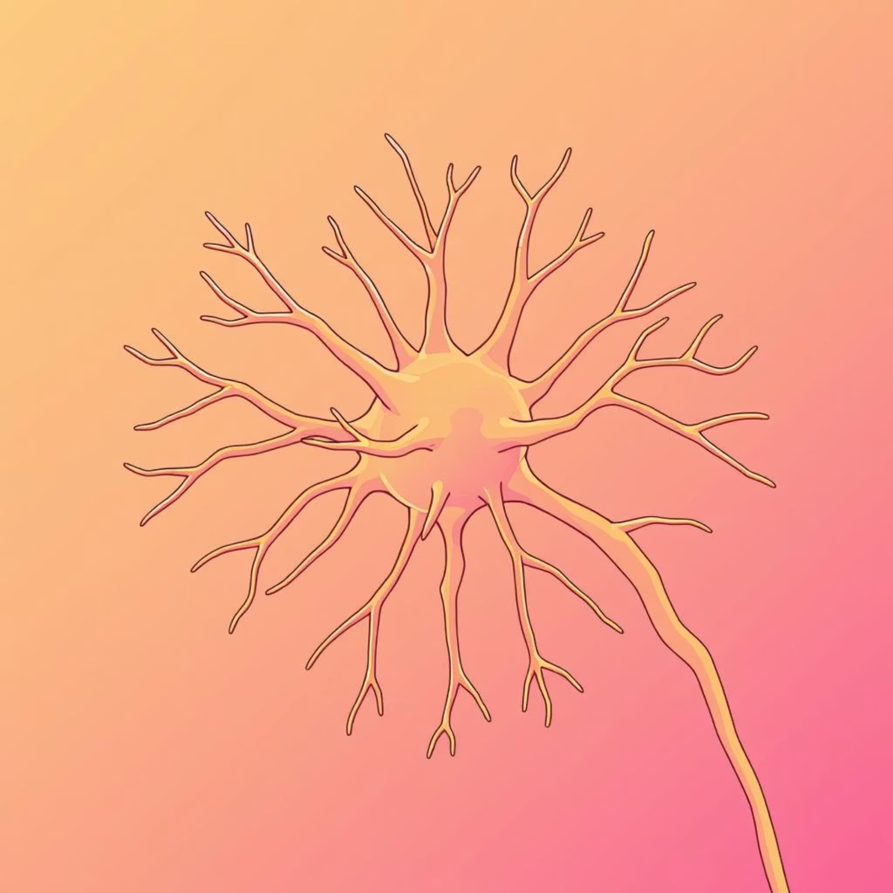
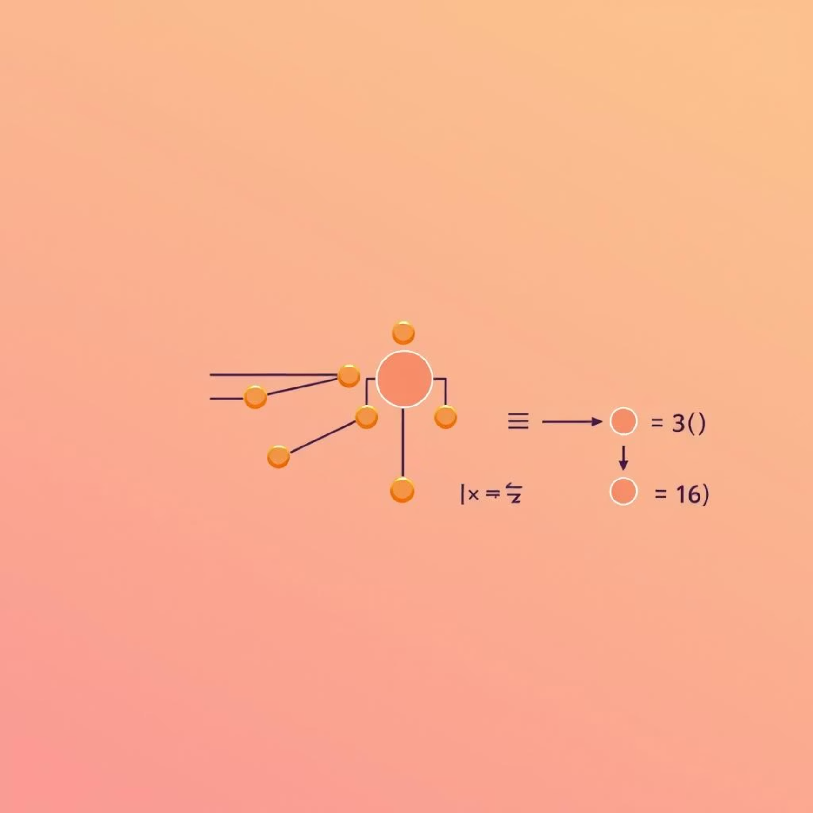
Biological vs. Artificial Neurons
Biological Neuron
Artificial Neuron
Inspired by the human brain, artificial neurons mimic the way our brains process information. Biological neurons receive signals through dendrites, process them in the cell body, and transmit output via axons. This complex biological structure allows for intricate thought and learning.
Artificial neurons, or "nodes," receive numerical inputs, apply weights, sum them up, and pass the result through an activation function to produce an output. This simplified model captures the essence of information processing, enabling machines to learn patterns from data.

Slide 4



Perceptrons: The Simplest Network
Input & Weights
Summation
Activation Function
The perceptron takes multiple binary inputs, each multiplied by a corresponding weight. These weights represent the importance of each input, acting as adjustable parameters that the network learns during training.
All weighted inputs are summed together, and a bias term is added. This sum then determines the "activation" level of the neuron before it is passed to the activation function.
The sum is fed into a step activation function. If the sum exceeds a certain threshold, the perceptron "fires" and outputs 1; otherwise, it outputs 0. This binary decision makes it a simple classifier.
Invented in 1957, the perceptron was one of the first algorithms for training a single-layer neural network. It's the foundational building block for understanding more complex neural architectures.

Slide 5

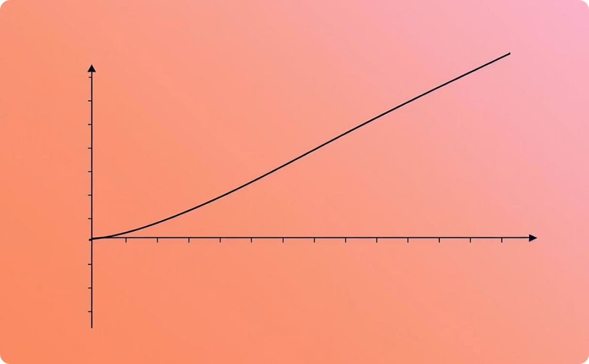

Activation Functions: Sparking Action
Activation functions introduce non-linearity into the network, allowing it to learn complex patterns and relationships in data. Without them, a neural network would simply be a linear regression model, regardless of its depth.
Sigmoid
ReLU (Rectified Linear Unit)
Tanh (Hyperbolic Tangent)
Compresses values between 0 and 1, useful for binary classification where probabilities are needed. However, it suffers from vanishing gradients for very large or small inputs.
Outputs the input directly if positive, otherwise zero. Widely popular due to its computational efficiency and ability to mitigate vanishing gradient problems. It’s effective for hidden layers.
Similar to Sigmoid but outputs values between -1 and 1. It is zero-centered, which can make training more stable than with Sigmoid. Often used in recurrent neural networks.

Slide 6



Forward Propagation: The Flow of Information
Forward propagation is the process where input data is fed through the neural network, layer by layer, to produce an output prediction. It's the "prediction" phase of the network's operation.
Input Layer
Hidden Layers
Output Layer
The initial data points (features) are fed into the first layer of the network. Each neuron in this layer represents an input feature.
The data passes through one or more hidden layers. In each hidden layer, neurons perform weighted sums of their inputs and apply activation functions. This transforms the data into more abstract representations.
The final layer produces the network's prediction. The type of activation function in the output layer depends on the problem (e.g., Sigmoid for binary classification, Softmax for multi-class classification).

Slide 7
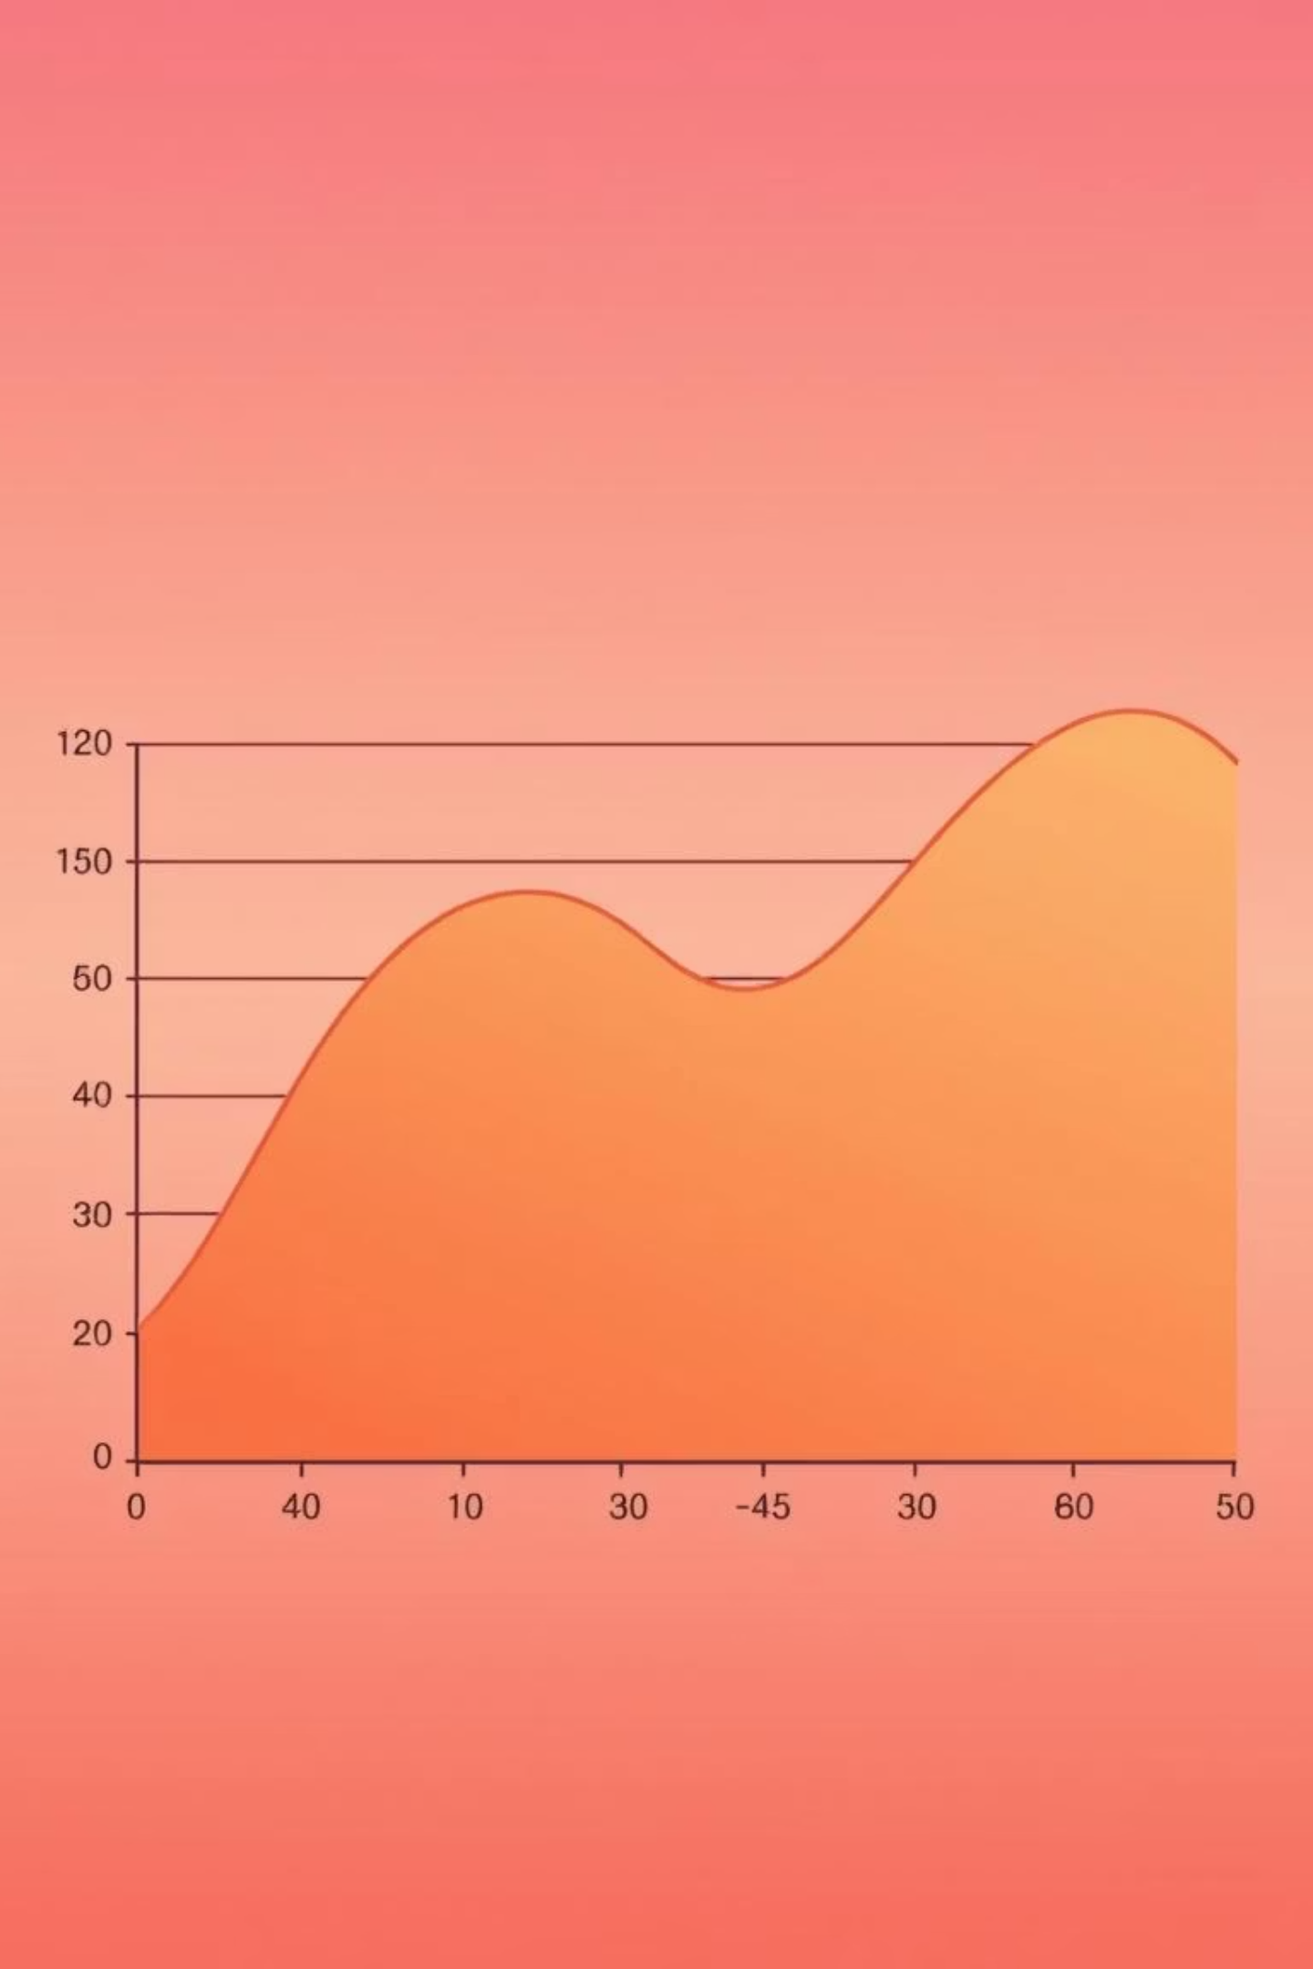
Loss Functions: Measuring Model Error
A loss function quantifies how well the neural network is performing by measuring the discrepancy between the network's predictions and the actual target values. The goal during training is to minimize this loss.
Mean Squared Error (MSE)
Commonly used for regression problems. It calculates the average of the squared differences between predicted and actual values. Penalizes larger errors more heavily.
Cross-Entropy Loss
Primarily used for classification problems. It measures the dissimilarity between two probability distributions: the predicted probabilities and the true labels. Lower values indicate better performance.

Slide 8
Optimization: Learning from Mistakes
Optimization algorithms adjust the network's internal parameters (weights and biases) based on the calculated loss, aiming to minimize it. This iterative process allows the network to "learn" from its errors.
Gradient Descent
1
The most fundamental optimization algorithm. It calculates the gradient of the loss function with respect to each parameter and moves in the direction opposite to the gradient, incrementally reducing the loss.
2
Learning Rate
A crucial hyperparameter that controls the step size taken during each iteration of gradient descent. A well-tuned learning rate is vital for efficient convergence without overshooting the minimum.
Stochastic Gradient Descent (SGD)
3
Instead of calculating the gradient over the entire dataset, SGD computes it for a single randomly chosen training example at each step. This makes training faster, especially for large datasets.

Slide 9



Backpropagation: The Learning Engine
Backpropagation is the core algorithm for training neural networks. It efficiently calculates the gradients of the loss function with respect to all the weights in the network, allowing for their adjustment.
Error Calculation
After forward propagation, the loss function calculates the error between the network's output and the true labels.
Gradient Computation
The error is propagated backward through the network, using the chain rule of calculus to compute how much each weight contributed to the overall error.
Weight Update
These gradients are then used by an optimization algorithm (like Gradient Descent) to update the weights and biases, bringing the network's predictions closer to the true values.

Slide 10
Key Takeaways & Next Steps
Neurons are the foundation: Both biological and artificial neurons are fundamental processing units.
Perceptrons are simple classifiers: The simplest form of a neural network.
Activation functions enable non-linearity: Crucial for learning complex patterns.
Forward propagation is prediction: How input data generates an output.
Loss functions quantify error: Guiding the learning process.
Optimization adjusts parameters: Minimizing loss and improving performance.
Backpropagation is the learning algorithm: Efficiently updating weights.

